Slide 1

Customer Retention Marketing: Churning Customer Data
Presentation by - SWAN do attitude

Slide 2
27%
More than 1 in 4 customers have churned—1,869 out of 7,043. Swan Teleco is losing ground.

Slide 3

Churners - who are they? And why are they leaving?

Slide 4
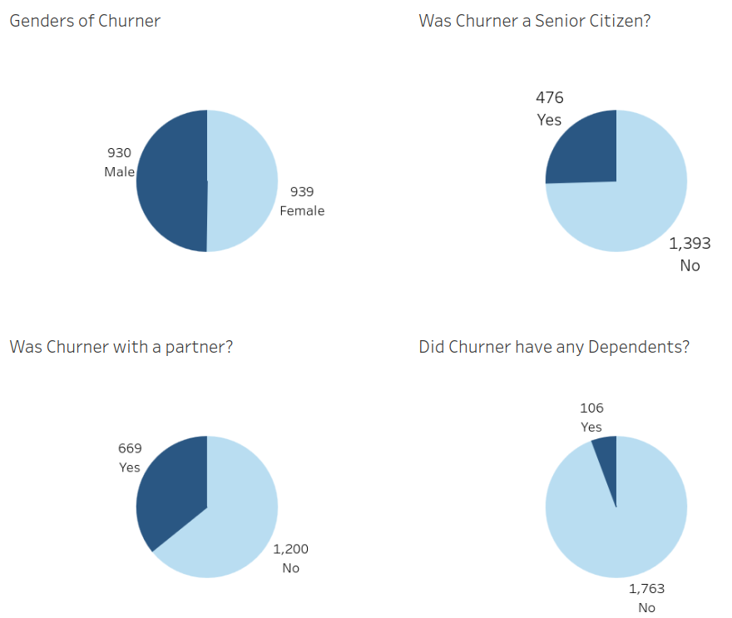
Typical Characteristics
From the charts shown here, the majority of Swan Teleco’s churners are:
Single
Have no dependents in the household
Are not a Senior Citizen
From the data, gender currently has no correlation with churning.

Slide 5
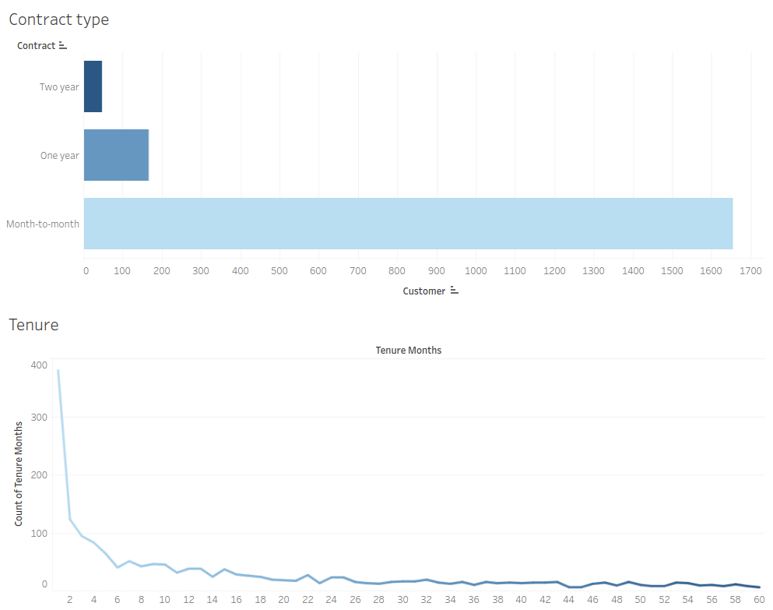
Churners - Contract Type vs Tenure
Here we can see that 85% of churners were contracted with Swan Telecom on a Month-to-month basis.
This highly correlates with the churners’ months of tenure.
We can see on our line graph that the majority of your churners are leaving within 6 months of them starting. There is a far lower churn rate among customers who have a tenure of 12 + months.
This clearly suggests that pushing for customers to commit for at least a year instead of offering month-to-month contracts would cause greater retention.

Slide 6
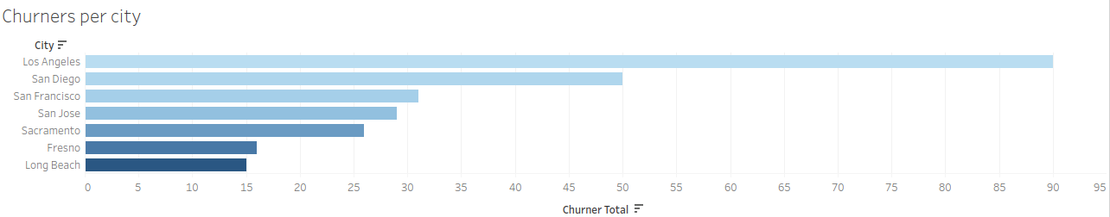
Churners - Areas of Concern
Los Angeles and San Diego stand out as the cities with the highest number of churned customers. This concentration may be driven by local market dynamics. For instance - a local, competing provider in these areas could be offering more attractive rates or packages, drawing customers away from Swan Teleco.

Slide 7
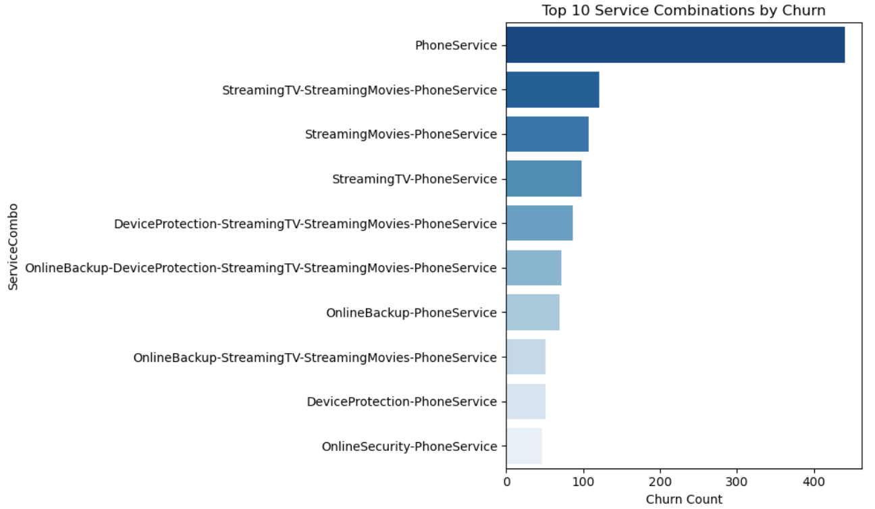
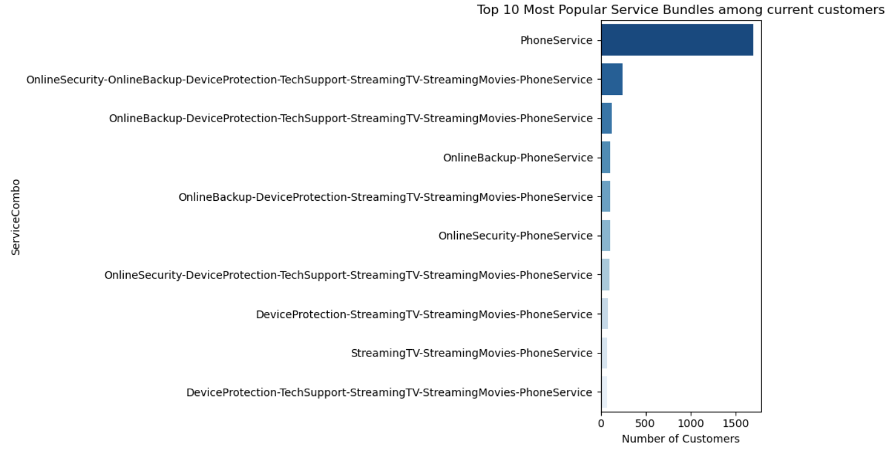
Churners - Service Combinations
Customers on a Phone Service only contract were by far the biggest contributors to churners compared to all other multi-service packages. This could be for such reasons as;
Competitors offering better rates on handsets/data
Less hassle to rearrange multiple services when only contracted to one.
If we compare this to the most popular bundles of current customers, 1699 customers are on a Phone Service only contract. This is 33% of your current customer base in a high-risk position! These customers are statistically more likely to churn, based on historical patterns.

Slide 8
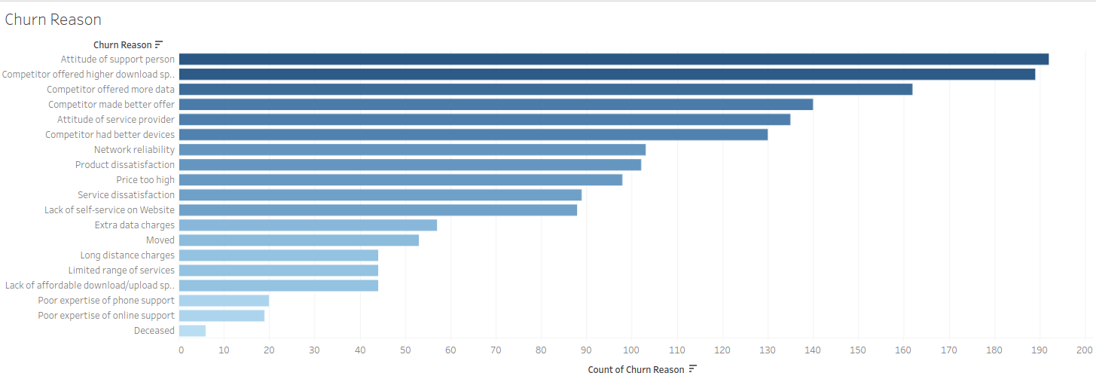
Reasons for Churning
From the above graph, we can see there are two key reasons why Swan Teleco’s customers are churning:
The attitude of the support person or service provider was of such a poor standard, it warranted terminating the contract.
Competitors are offering better services than Swan Teleco are providing, whether that be more data, higher download speed, or better devices.

Slide 9
Summary
Suggested improvements:
More focus on getting customers to commit to longer term contracts, avoid month-to-month where possible.
Investigate competitor rates in major cities to offer competitive prices in these high-churn areas.
Incentivise multi-service packages to customers.
Training for phone operators at Swan Teleco and Service Providers, to improve the customer experience.
Proactively reach out to customers requesting a feedback survey to establish customer satisfaction
Key factors attributed to churning:
Single, young/middle-aged adults without dependents
Being on a month-to-month contract
Likely to be living in a major city (Los Angeles, San Diego etc)
Being on a Phone Service only contract
Competitors offering better services/rates
Have experienced a poor level of customer service from either technical support or service provider.

Slide 10

Churn Prediction Model
Decision Path and Key Insights

Slide 11
What does our model do, and how does it work?
We’ve established which key factors are highly correlated with churning, so how can we tackle this?
We have created a model that can accurately predict the likelihood of current customers churning, based on their characteristics and current contractual set up.

Slide 12
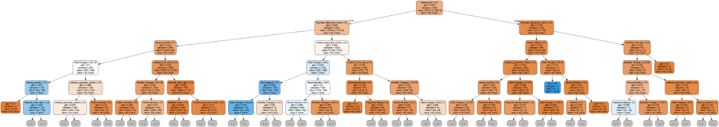
Modelling
What We Trained and Why
Random Forest Churn Prediction
This visual shows one decision path from our Random Forest churn model. Each node represents a feature-based split (e.g. tenure, contract type, payment method), guiding the model’s prediction based on customer attributes.
Orange - Churn Blue - No Churn
This tree highlights how the model uses combinations of features to classify customers, offering transparency into the decision logic behind churn predictions.
We've limited the depth to keep the visual clear and focused, helping stakeholders understand how churn risk is assessed without overwhelming detail.

Slide 13
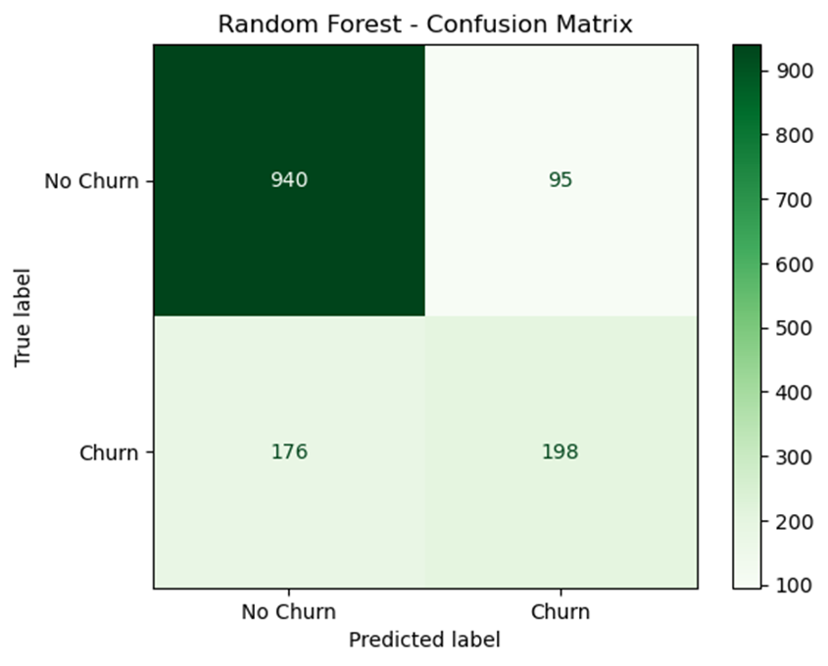
Model Performance
How well did the model perform on unseen data
This confusion matrix visualises how well our Random Forest model predicts customer churn. Each cell shows the number of customers falling into each prediction category:
True Negatives (No Churn predicted correctly): 940
False Positives (No Churn predicted as Churn): 95
False Negatives (Churn predicted as No Churn): 176
True Positives (Churn predicted correctly): 198
This matrix helps us understand where the model excels and where it may need refinement - especially in reducing missed churn cases.
Note: Based on 20% test data

Slide 14
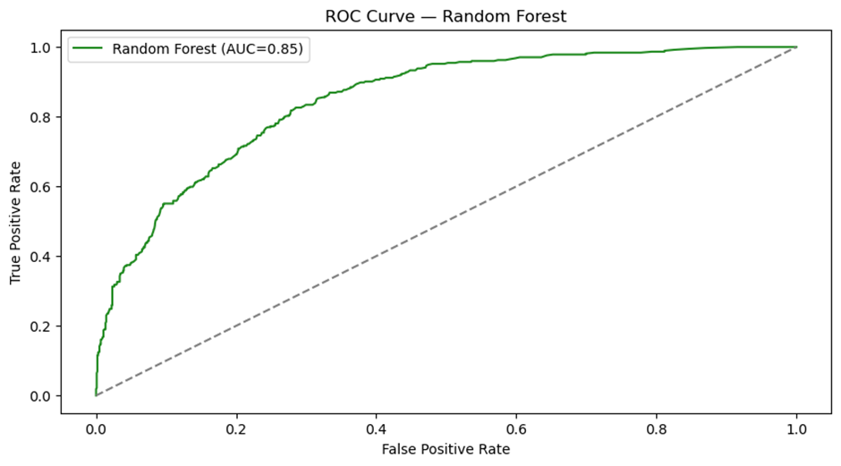
Model Performance Summary
How Well Does the Model Predict Churn?
Accuracy: 80.77%
Overall, the model correctly predicts churn vs. non-churn in ~81% of cases.
Precision: 67.58%
When the model predicts churn, it's correct ~68% of the time.
Recall: 52.94%
It captures ~53% of actual churners - room to improve sensitivity.
F1 Score: 59.37%
A balanced measure of precision and recall.
ROC-AUC: 84.72%
Strong ability to distinguish churners from non-churners across thresholds.
Performance

Slide 15
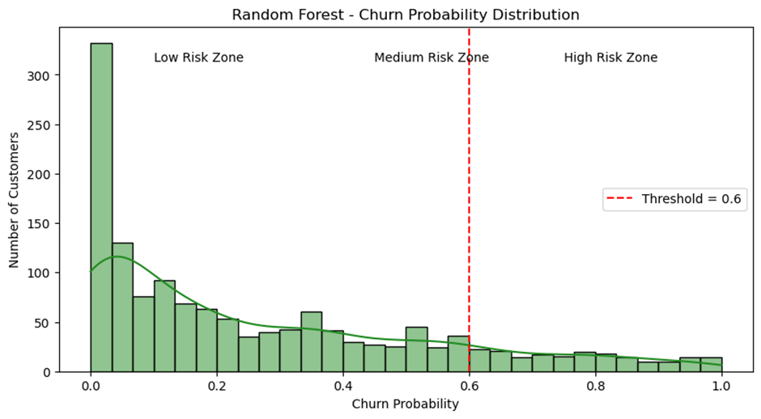
Churn Probability Distribution
How churn risk is spread across customers
This histogram shows how churn probabilities are distributed across the test set (20%).
The red dashed line marks the 60% threshold used to classify customers as high-risk.
Most customers fall into the low-risk zone, with churn probabilities near 0.
This graph helps prioritise interventions and assess model confidence.
Note: Full churn probabilities are not available for all customers due to the 80/20 train-test split. .

Slide 16
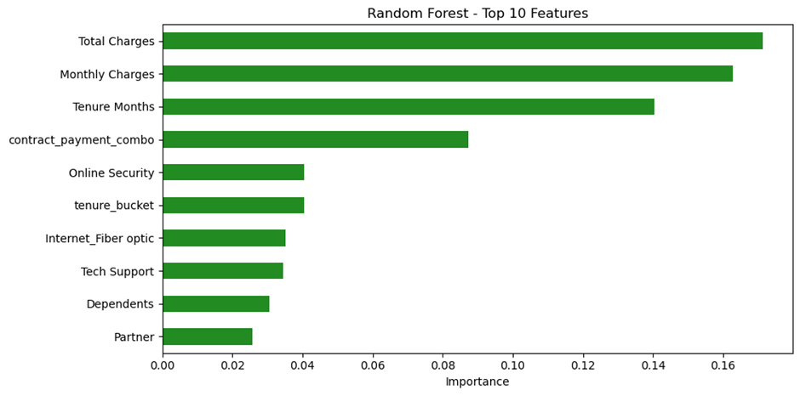
Key Drivers of Churn and Retention
What influences these factors
Most Linked with Churn
Short tenure (<12 months)
Monthly contracts
Electronic cheque payments
No streaming support
Most Linked with Retention
Long tenure (>24 months)
Two-year contracts
Automatic bank payments
Streaming services supported
Our Random Forest model highlights the most influential factors behind customer churn and retention.
Customers are more likely to churn when they have short tenure, monthly contracts, and limited service engagement.
Conversely, long-term customers on multi-service packages with stable payment methods are more likely to stay.

Slide 17

Retention
How to keep the most at-risk
customers?

Slide 18
Sign up factors to focus on
Following the guidance of our highly accurate prediction model, along with our analysis into previous churners, we strongly believe the following factors have the best correlation with retention, and should therefore be focussed on when discussing contract renewals with existing customers, or onboarding new customers:
Two year minimum contracts
Automatic bank payments
Multi-Service packages, including streaming services

Slide 19

Incentives
Offer new customers a welcome discount and highlight perks of staying with the service long-term
Offer discounts if customers choose to switch to a yearly plan instead of monthly
Offer free trials for add-on services/ streaming services and consider offering discount for bundle services
Have an incentive to switch to automatic bank payments (e.g. discounted rates)
Consider creating a loyalty program for long-term customers to keep them engaged
Use churn-linked data to identify at-risk customers and offer personalised retention deals
Create a referral scheme for existing customers (who have been with the service >3 months to refer friends/family) where both parties receive discounts

Slide 20
Further documentation
To accompany the information in this slide deck, we have also provided the following documents:
Notebooks on our model and churner EDA, for a deeper dive into the intricacies of our analysis
A PDF explaining the process of model creation and considerations taken
A csv file of the top 500 customers who are most likely to churn, for the attention of Swan Teleco’s Sales Department to offer incentives in aim of retention.
A separate csv file of all current Swan Teleco’s customers, each with their individual % churn likelihood, for the attention of your Customer Service Team.

